Slide 1
Real Estate Future Values
An insight into future regions to invest in

Slide 2
Outline
Business Problem
The Data
Methodology
Results
Recommendations

Slide 3

Business Problem
Determine which Region to invest in that will show the best returns over the next year

Slide 4

Data
The data is a univariate time series segmented into regions, states and cities.

Slide 5
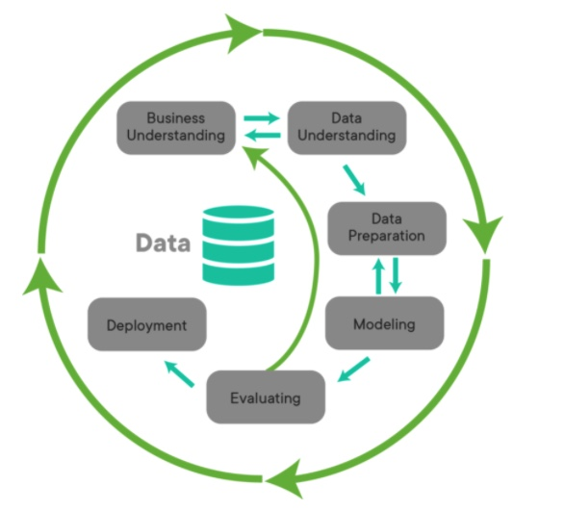
Methodology
1. Overview of Business Understanding
2. Data Understanding
3. Data Preparation
4. SARIMA Modeling
5. RNN Model
5. Evaluation

Slide 6
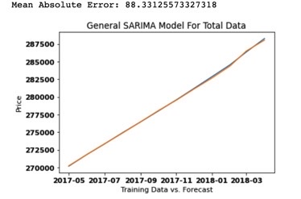
Model Metrics
A General SARIMA Model was created
SARIMA Model was able to forecast the Y Train with a Mean Absolute Error of 88 USD
88 USD as prices ranged in the 100s of thousands of dollars

Slide 7
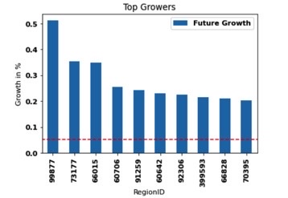
Identifying Top Growers
A General SARIMA Model was created and used to forecast future growth
Top 10 Growers were then identified, all of which were pegged to grow above 20% in the next year (5x larger than the average growth of 5% identified in the dotted red line)

Slide 8
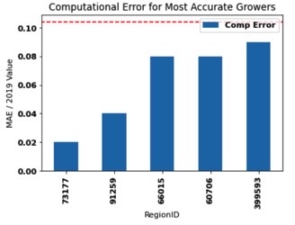
Identified Most Accurate Growers
The top 5 Most Accurate Growers were identified by dividing he Mean Absolute Error against the predicted 2019 Value
The Average Computation error was 10% (shown as a red dotted line)

Slide 9
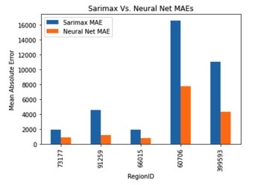
Compared SARIMA Models vs. RNN Models for Most Accurate Growers
Neural Nets continued to out preform SARIMA models, often reducing MAE’s by 50%

Slide 10
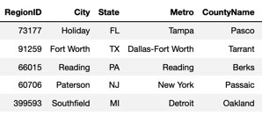
Recommendation
Invest these top 5 Regions, using the Neural Network forecasts as a basis for potential profits

